Slide 1
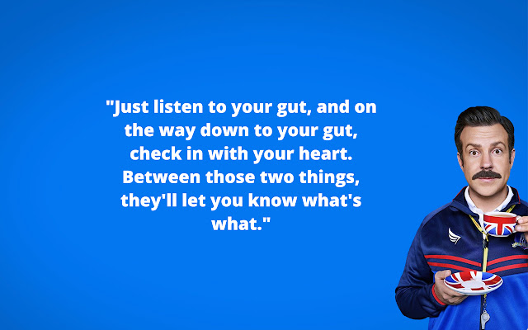
Welcome Transplant Social Workers!

Slide 2
STSW Annual Meeting
Wednesday, October 11, 2023
Lowes Coronado, San Diego, CA

Slide 3
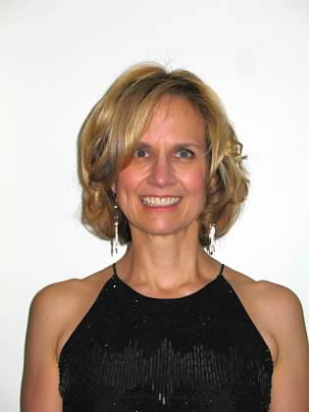
Secretary’s Report
Dawn Warfield, LCSW-C, CCTSW-MCS
Johns Hopkins Hospital
Minutes from the 2022 Annual Meeting are available on the website.

Slide 4
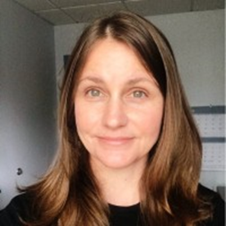
Treasurer’s Report
Kristen DeVoe, LICSW, CCTSW
Beth Israel Deaconess Medical Center
2022 Annual Profit and Loss Statement available on the website

Slide 5
  Treasurer’s Report: 2022 Income
5￼

Slide 6
  Treasurer’s Report: 2022 Expenses
6￼

Slide 7
Brief Highlights of 2023

Slide 8
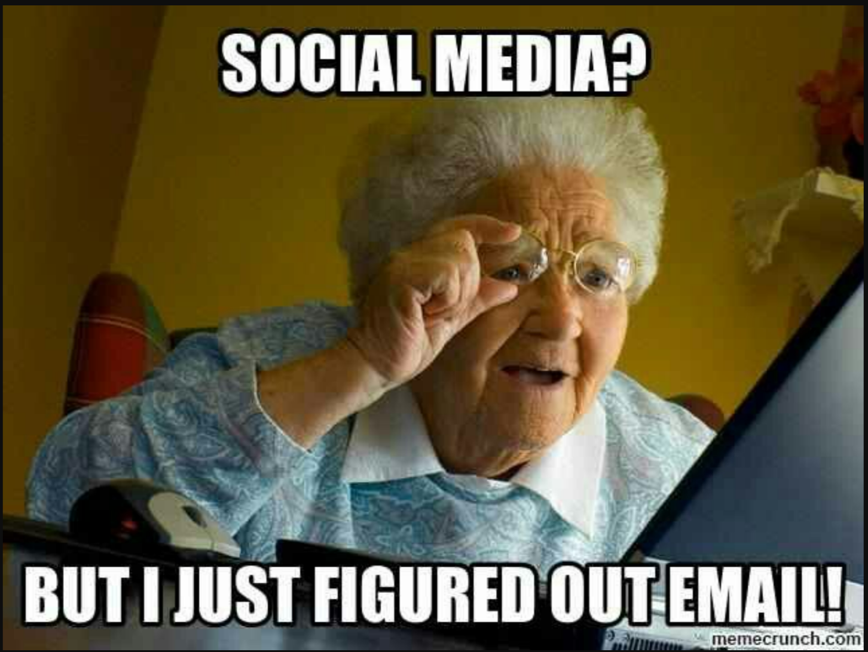

Slide 9

Tag us on Instagram!
#STSWsancon2023 #STSW #transplantsocialwork

Slide 10
2023 STSW Survey
Survey invitations were sent to all 508 STSW members
169 social workers responded

Slide 11
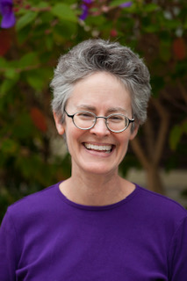
STSW Member Survey
This year, the STSW Research committee accepted the responsibility of distributing and analyzing the annual survey.
Thanks goes to Gloria Chen, Sarah Larmore, Kate Artin and Colleen Satarino for analysis and Tiffany Coco for support.
HUGE Thank you to Laurie McDonald who designed and analyzed the survey for 12 years. Laurie embodies dedication and hard work. Laurie has made a lasting contribution to STSW.

Slide 12
US Salaries
12

Slide 13
Interesting Survey facts
Participation in the Survey was lower this year than in past years. We continue to attribute that to electronic communication fatigue and not enough time in the day to get everything done.
Just under 80% of members surveyed are licensed at the highest level in their state and just under 50% are credentialed through the STSW. This is a slight decrease in both members at their highest license level and in CCTSW credentialed members
For compensation comparisons within your UNOS region and other organ specific data, please refer to the full survey results on the website.
Please participate in the STSW membership survey next year!

Slide 14

UNOS Transplant Management Forum

Slide 15
CEUs
We continue to offer transplant-specific contact hours for members participating in education calls with the Chairs of our various organ-specific committees. Members can use these hours toward initial applications and re-credentialing for the CCTSW, CCSW-MCS, and CCTSW-MCS. Please reach out to the Chairs for additional information.
Beats By Social Work Podcast has episodes that can count towards credentialing.
We continue to explore opportunities to support virtual learning and appreciate the feedback from members on the importance of offering distance learning in additional to in person conferences.
Visit the STSW website for links to additional transplant-specific CEUs.

Slide 16
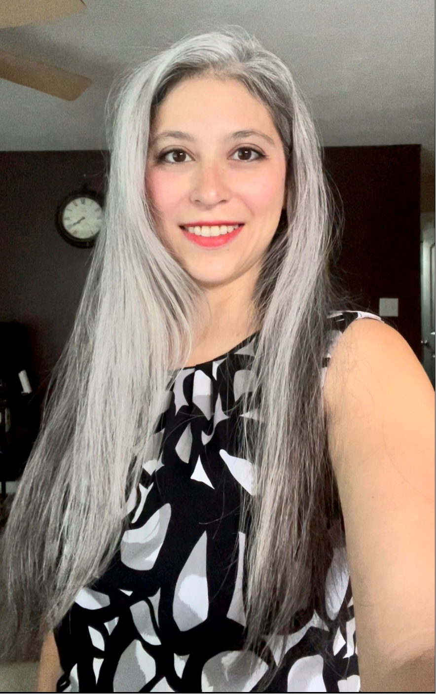
Membership/Scholarship Report
Sarah Larmore, LCSW, CCTSW, Intermountain Transplant Services– Membership Chair
We have 535 active members which is lower than the previous two years. We are dedicated to our transplant social work family and would welcome ideas for increasing membership and/or retention.
Renewal memberships are due every 12 months. You will get 3 email reminders. (2 before & 1 after renewal date)
20 scholarships were awarded this year by the STSW
You are all valued members of our society! Thank you for making us a successful organization.

Slide 17
Committee Participation Opportunities
2023 - We have 16 committees. Every board position has a committee to support the work of the Society.
Board positions can be viewed on the STSW website under the About the Board Members tab.
For committee participation opportunities please see the about section of the conference website, visit the STSW table to view sign-up sheets, or sign up through the conference app.

Slide 18










The Society for Transplant Social Workers Appreciates Our 2023 Exhibitors
Notes:
Add additional exhibitors

Slide 19
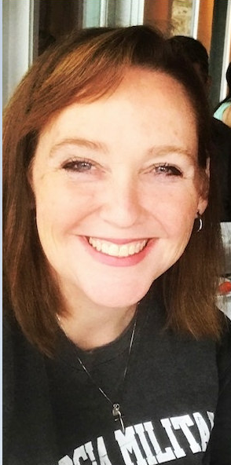
STSW Credentialing

Slide 20
Credentialing Update
As of 9/30/2023:
 | Newly credentialed | Total Re-credentialed | Total credentialed
CCTSW | 25 | 41 | 166
CCSW-MCS | 1 | 0 | 6
CCTSW-MCS | 5 | 12 | 51
Totals | 31 | 53 | 223

Slide 21



Congratulations to our new CCTSW, CCTSW-MCS, and CCSW-MCS recipients!
2023
Jennifer Adams
Rosanne Alo
Letitia Bishop
Brooke Bolinger
Taunya Clarke
Jillian Cotton
Lauren Daily
Melissa Dorris
Laura Dunn
Megan Fecht
Chelsea Flohe
Melissa Graves
Nikole Krueger
Gabrielle LeMarier
Gloria Martinez
Joy Melo
Cheryl Morris
Sarah Padilla
Matthew Paek
Mary Phillips
Rose Quigley
Iesah Sims
Lauren Smitherman
Paulette Toledo
Charles Wilson
Mary Alexander
Debra Clark
Jennifer Leonard
Melinda Ortega
Allie Sakai
Mary Weatherby

Slide 22
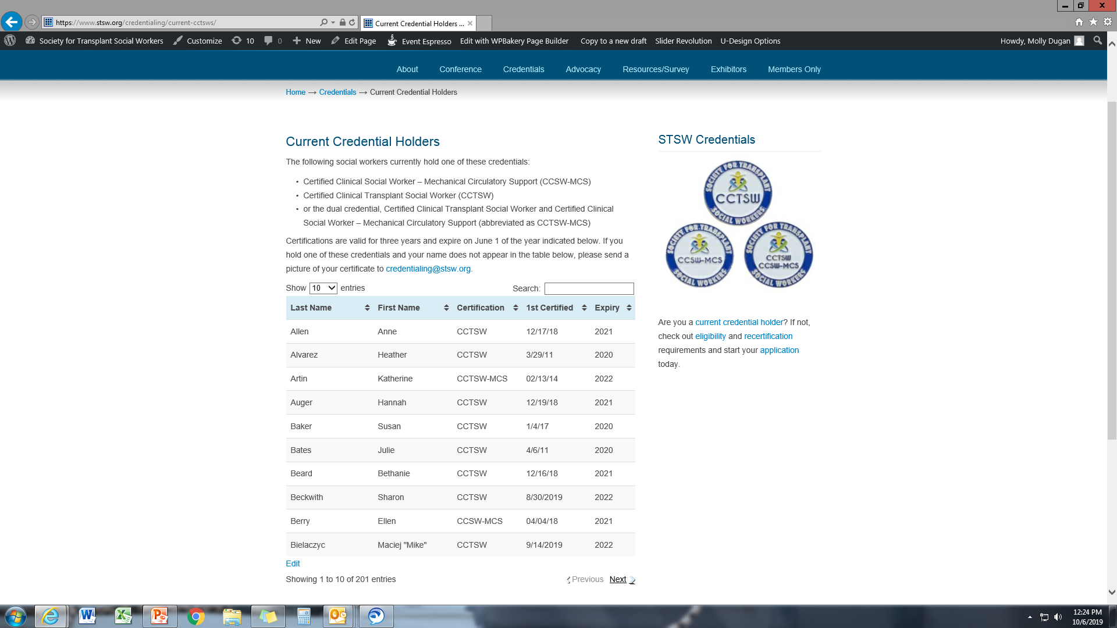
Credentialing Update
 | 2018 | 2019
CCTSW | 30 | 27
CCSW-MCS | 2 | 1
CCTSW-MCS | 5 | 7

Slide 23
Appointments of Board Members
Pediatric Chair - Tina Cole
National Program Co-Chair - Megan Homsy
Research Co-Chair - Gloria Chen
Social Media/Marketing Chair - Tiffany Coco
Secretary – Lara Tushla (to be voted in by the membership at this conference)
Treasurer – Chrissi White (to be voted in by the membership at this conference)

Slide 24
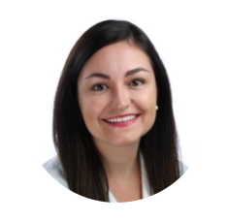

Election
We re-elected the roles of President and Vice President last year, and will be electing the roles of Treasurer and Secretary this year.
We present the candidates for Secretary, Lara Tushla, and Treasurer, Chrissi White.

Slide 25
Appreciations
2022 Conference Committee: Kelli Swan-Vranish/Site Chair, Nina Sullivan and Rachel Liber (all from UC San Diego Health System)
Kay Kendall – National Conference Chair
Beth Piotrowicz – National Program Co-Chair
Kathy Daley – National Program Co-Chair
Megan Homsy – Incoming National Program Co-Chair
Lisa Smith– National Exhibitor Chair
Deb Gordan – Immediate Past National Exhibitor Chair
Katie Newton – Vice President/Technology Chair
Kristen DeVoe – STSW Treasurer
Barb Levine – STSW Virtual Assistant

Slide 26
Appreciations
Executive Committee – 6
Board of Directors – 25
We’d like to thank all members who have served on a committee or taskforce.

Slide 27
Appreciations
We recognize the following Board Members as they complete their terms at the end of this year.
Lisa Smith – Exhibitor Chair for 2023
Beth Piotrowicz – National Program Co-Chair since 2017
Daniela Matz – Multicultural Chair since 2019
These women have been integral to their areas of expertise in our Society!

Slide 28
Appreciations
We recognize the following long-standing Executive Committee Board Members as they also complete their terms at the end of this year.
Kristen DeVoe – Treasurer since 2019
Dawn Warfield – Secretary since 2020
These women have been instrumental in the growth of the Society and their contributions to the Society are immeasurable on ongoing!

Slide 29
Awards
Lee Suszycki Memorial Award
Lee Suszycki was the founder and first president of our Society. She was passionate about many things, including education, writing, publication, social work and transplantation. The Society for Transplant Social Workers is a direct outgrowth of her vision for social workers practicing in transplantation.

Slide 30

Lee Suszycki Memorial Award
Beth Piotrowicz, LICSW-S, CCTSW
Cleveland Clinic Children’s, Cleveland, OH
Clinical Transplant Social Worker

Slide 31
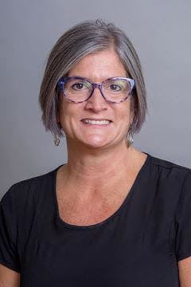
Lee Suszycki Memorial Award
Kathy Daley, LICSW-S, LCSW, CCTSW
Cincinnati Children’s Hospital Medical Center, Cincinnati, OH
Clinical Transplant Social Worker

Slide 32
Awards
Judy Midelfort Memorial Award
Judy Midelfort was a founding member of the Society, one of the first to publish on psychosocial issues in transplantation, and a strong supporter of professional growth and education.

Slide 33

Judy Midelfort Memorial Award
Emily Walz, LCSW, CCTSW
National Living Donor Assistance Center
Outreach Coordinator

Slide 34
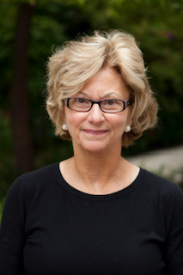
2024 and beyond
You can host a conference in your city!
STSW has a national conference committee, national exhibitor chair, and a corporate meeting planning contract. But we need a local committee to make the conference a success.
We are always looking for new cities to host our conference! Will it be your city? Let us know if you are interested.

Slide 35
Conference 2024
Madison, WI
October 7-10, 2024
Monday – Thursday
Monona Terrace Community and Convention Center
https://youtu.be/Lno4cPm61zE?si=FjiLFWVmfIBXaaea

Slide 36
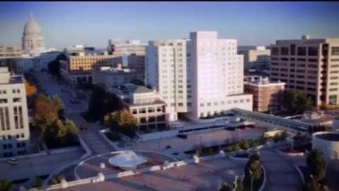
Madison, WI October 7-10, 2024

